Slide 1



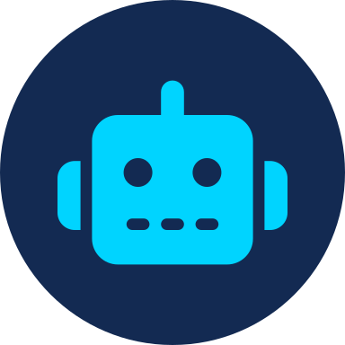




NETAJI SUBHAS INSTITUTE OF TECHNOLOGY
AN EFFECTIVE SOURCE OF TECHNOLOGY
DEPARTMENT OF COMPUTER SCIENCE • B.TECH SEMINAR
Future of Jobs
and Skills
Preparing for the Changing World of Work
PRESENTED BY
Nandini Chandra | Laxmi Kumari | Sakshi Kumari
B.Tech, Computer Science • Academic Year 2025–2026
FUTURE OF JOBS AND SKILLS
01 / 10

Slide 2



INTRODUCTION
What Does the Future of Jobs Mean?
The nature of work is rapidly evolving, driven by technology, innovation, and shifting global demands.
AI and automation are transforming how tasks are performed across nearly every industry.
Globalization connects talent and opportunity across borders, reshaping traditional career paths.
Industries are restructuring around data, sustainability, and digital-first operations.
➜
➜
TODAY
TRANSITION
FUTURE
Manual & routine
task-based roles
AI, automation &
digital adoption
Human + AI
collaborative work
~44%
of core workforce skills are expected to change by 2027 as technology reshapes job roles (World Economic Forum).
FUTURE OF JOBS AND SKILLS
02 / 10

Slide 3



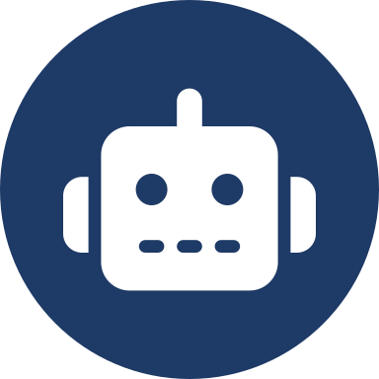



DRIVING FORCES
Why Are Jobs Changing?
Artificial
Intelligence
Every one of these forces is interconnected — a shift in one accelerates change across the rest, compounding the pace of transformation across industries.
Changing Consumer
Needs
CHANGING
JOB
LANDSCAPE
Automation &
Robotics
Green
Economy
Digital
Transformation
Globalization
FUTURE OF JOBS AND SKILLS
03 / 10

Slide 4



EMERGING CAREERS
Jobs of the Future
AI & Machine
Learning Specialist
Data Scientist
Cybersecurity
Specialist
Robotics Engineer
Cloud Computing
Professional
Renewable Energy
Specialist
UX / UI Designer
Digital Marketing
Specialist
FUTURE OF JOBS AND SKILLS
04 / 10

Slide 5
SHIFTING ROLES
Jobs That May Change or Decline
“ Technology changes tasks, not necessarily entire professions. ”
BEFORE — TRADITIONAL WORK
AFTER — TECHNOLOGY-ASSISTED WORK
Manual data entry & bookkeeping
Repetitive assembly-line tasks
Routine customer support queries
Manual document processing
Basic bank teller transactions
AI-assisted analytics & automated records
Robotics-managed production, human oversight
AI chatbots + human agents for complex cases
Smart document automation & e-verification
Digital banking, human advisory for complex needs
FUTURE OF JOBS AND SKILLS
05 / 10

Slide 6












HUMAN CAPITAL
Skills of the Future
TECHNICAL SKILLS
HUMAN SKILLS
Artificial Intelligence
Communication
Data Analysis
Creativity
+
Critical Thinking
Coding
Problem Solving
Cybersecurity
Leadership
Cloud Computing
Adaptability
Digital Literacy
Teamwork
FUTURE OF JOBS AND SKILLS
06 / 10

Slide 7








COLLABORATION
AI and Humans: Working Together
AI
HUMAN
Analysis
Empathy
Research
Ethics
Productivity
COLLABORATION
Creativity
Better decisions,
faster outcomes
Automation
Judgment
AI amplifies human capability — handling scale, speed, and data, while people bring the creativity, ethics, and judgment machines cannot replicate.
FUTURE OF JOBS AND SKILLS
07 / 10

Slide 8





ACTION PLAN
How Students Can Prepare
1
2
3
Student
Skilled Professional
Future-Ready Career
Build digital literacy
Learn AI tools
Develop communication skills
Work on real-world projects
Create a strong portfolio
Keep learning continuously
Develop adaptability
FUTURE OF JOBS AND SKILLS
08 / 10

Slide 9


THE BALANCE SHEET
Challenges and Opportunities
CHALLENGES
OPPORTUNITIES
Job displacement in routine roles
Widening skill gaps
Digital divide across regions
Constant need for reskilling
Ethical & privacy concerns
New careers in emerging fields
Higher productivity & efficiency
Growing entrepreneurship avenues
Flexible & remote work options
Stronger human-AI collaboration
FUTURE OF JOBS AND SKILLS
09 / 10

Slide 10

CONCLUSION
The future belongs not only to those who know technology, but to those who can continuously learn, adapt, and work with technology.
Jobs are evolving — not disappearing — through AI, automation, and innovation.
Success depends on blending technical skills with human strengths.
Continuous learning and adaptability are the real career currencies.
AI and humans, working together, unlock outcomes neither can reach alone.
Thank You
Netaji Subhas Institute of Technology • B.Tech, Computer Science • 2025–2026

